Slide 1

NCL Cyber Exercise Resource Monitor
Program Design Purpose
We want to create a monitor and observing tool-set which can visualize and evaluate the availability/state of the resource ( hardware, vm, container, program or service) being used in an on going cyber exercise or a cyber drill event to help the event organizer and participants to get better sense about the event real time progress. It also provide serval function to full filled the requirement of other teams in the cyber exercise. The main functions provide by the cyber exercise resource monitor which can be used by different teams:
Used by Black/Judgment team to monitor the whole exercise progress, each teams’ state/score, the availability of the resource and the defense progress.
Used by Green team to prepare, test and do debug work for building the exercise environment.
Used by Blue team to check and monitor the real time state of the exercise environment they are working on.
Used by Red team to report the attack state to judgement team.
Used by Yellow team to simulate the behavior of normal users.
Used by the Purple team to record the cyber exercise logs/event timeline and archive the information.
Auto detect and record the red team attack and defense action.
The Cyber Exercise Resource Monitor is built based on two exist product: Cluster User Emulator and Cluster Service Health Monitor.

Slide 2
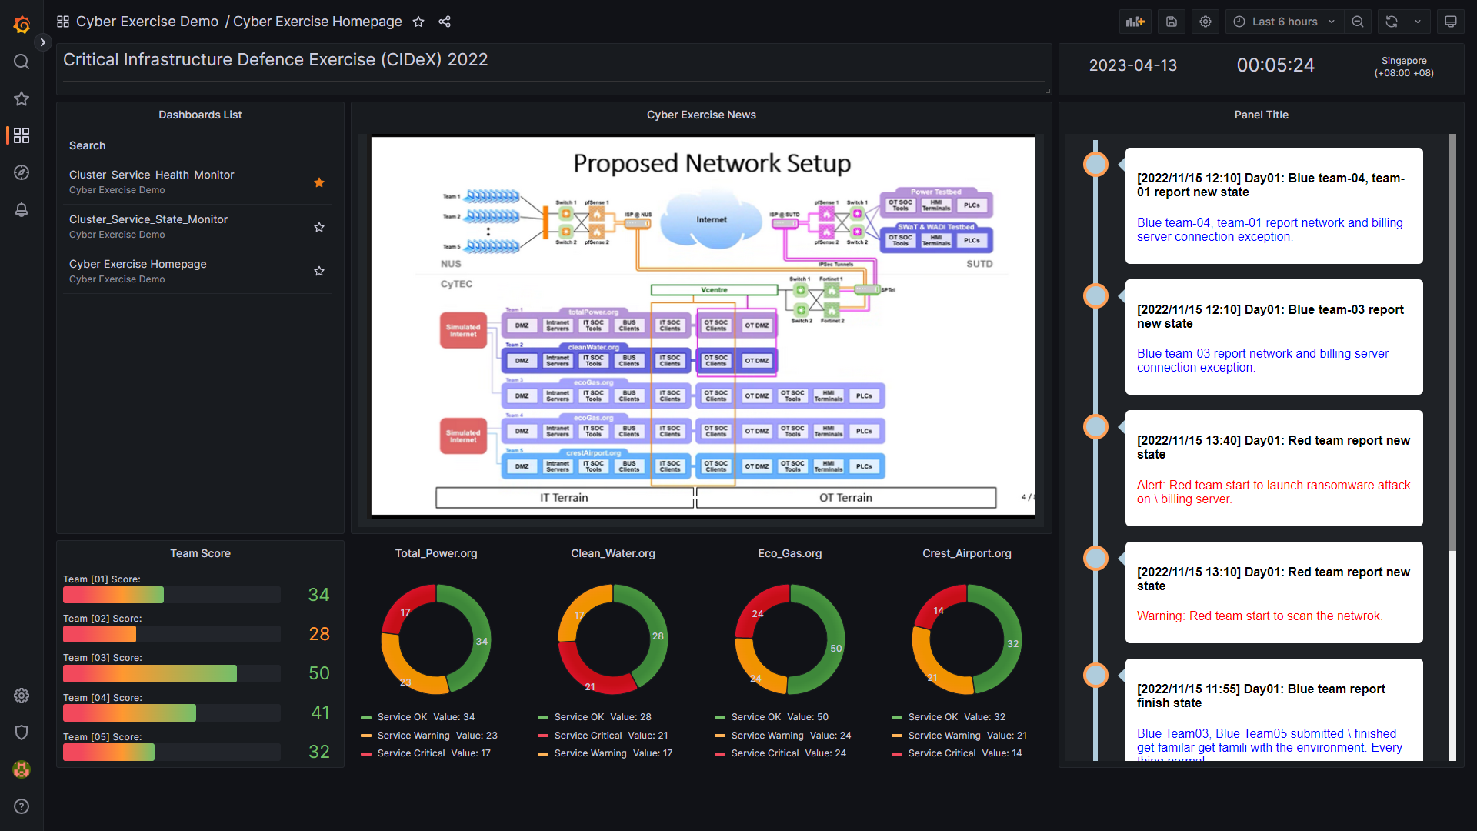
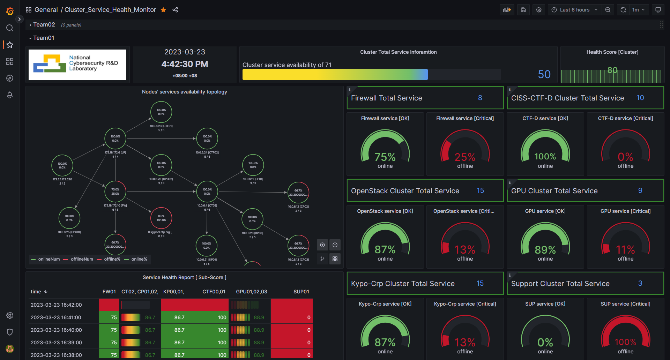
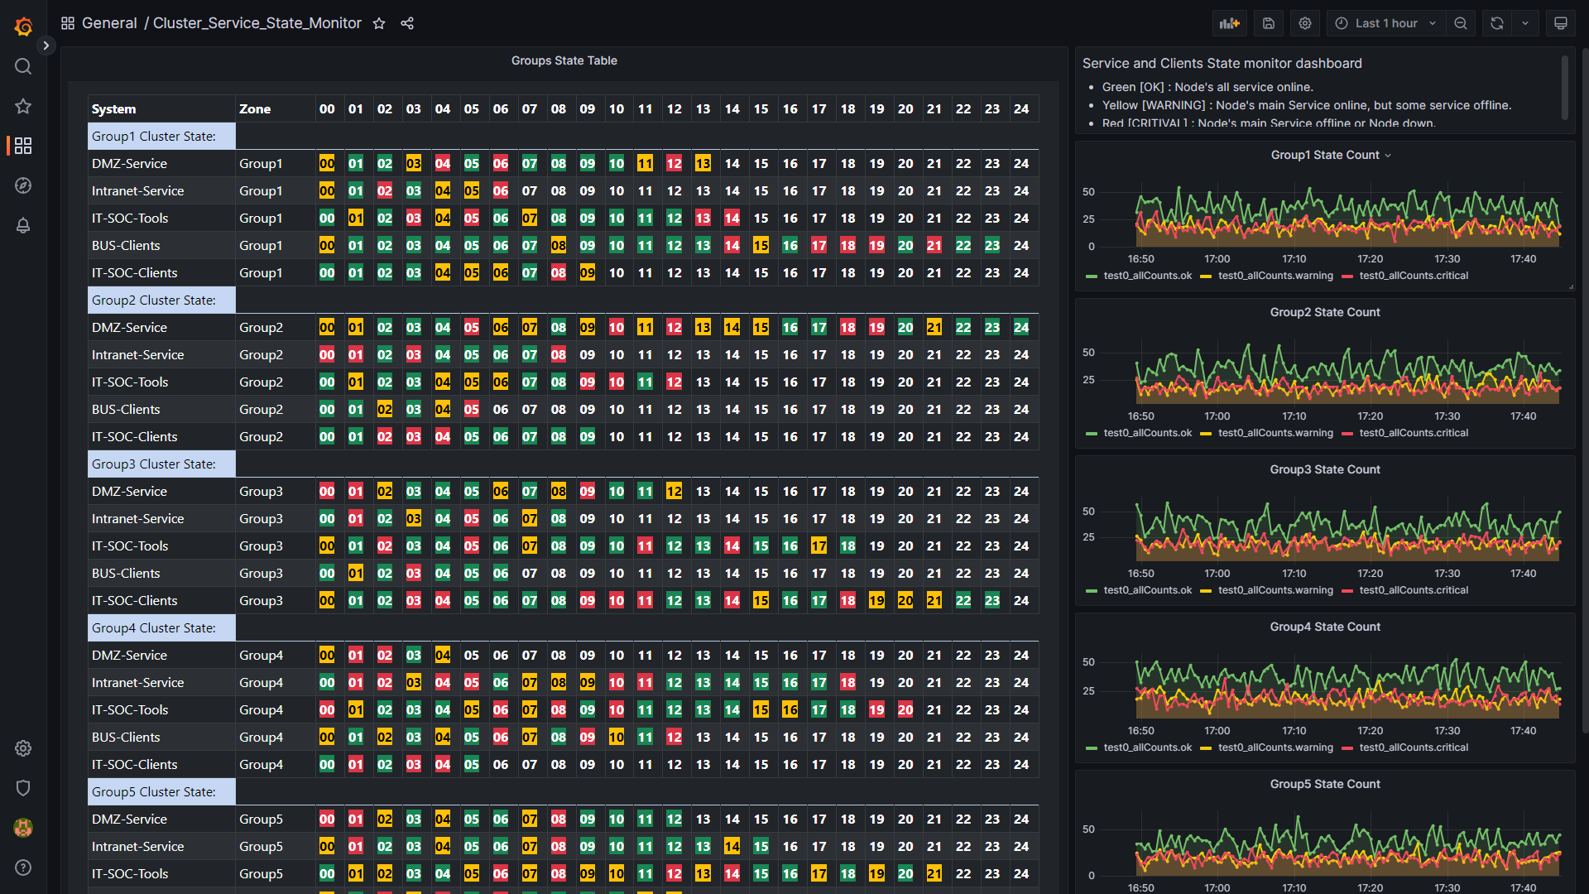
NCL Cyber Exercise Resource Monitor
Monitor Web Portal (dashboard)
The monitor will provide different web dashboard to visualize the state for different team to analysis:
Exercise Overview Dashboard: Used by Black/Judgement team monitor and control the whole exercise progress.
Service Health Monitor Dashboard: Used by Blue team to monitor the health and availability of their team exercise-cluster.
Resource Availability Monitor Dashboard: Used by Black/Judgement team, red team, blue team and purple team to monitor the detailed real time availability state of the resource.
Assistance function Dashboards: Used for full fill special monitor requirement of Yellow team and Green team.
Dashboard Screen Shot Example:

Slide 3
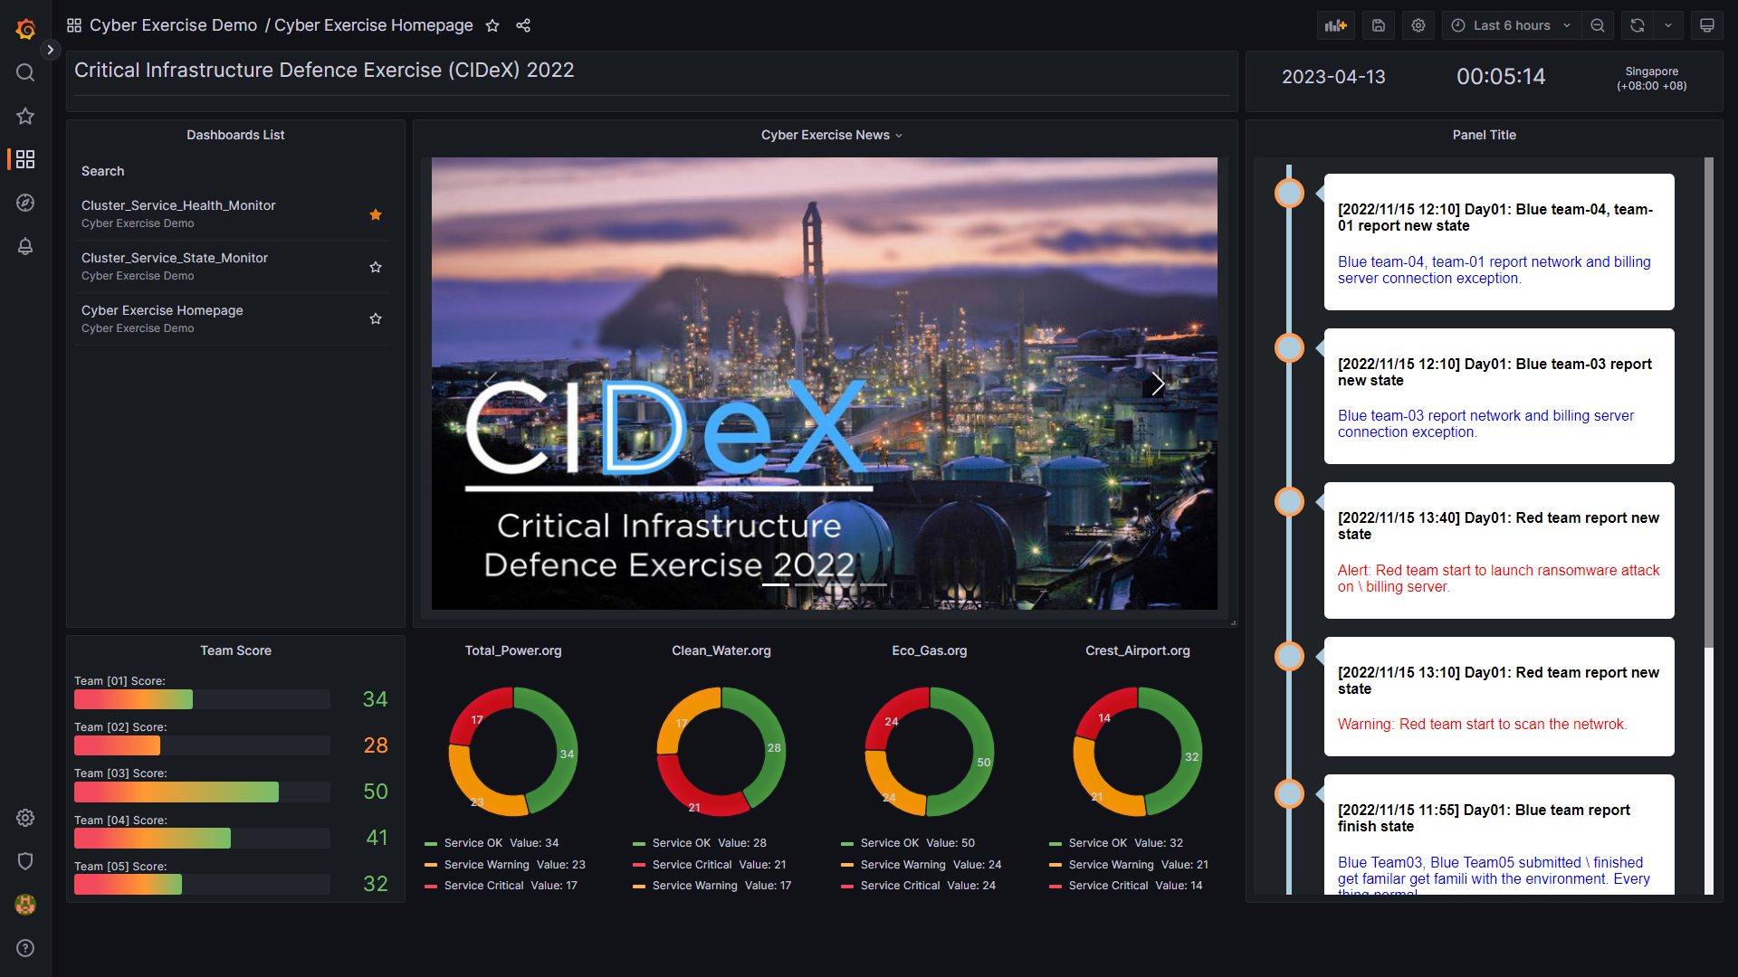
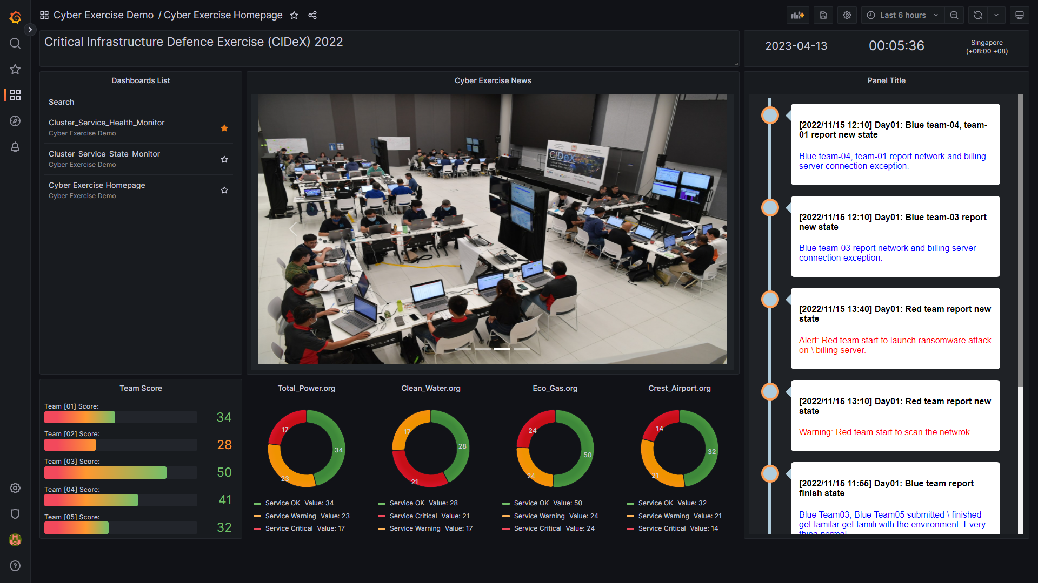
NCL Cyber Exercise Resource Monitor
1. Exercise Overview Dashboard
The Cyber exercise over dashboard is used by Black/Judgement team to monitor and control the whole exercise progress. The information it can provide:
Event latest news updating and exercise host venue live video.
Exercise attack and defence state .
The score of all blue teams, summary of tickets raise and resolved.
The availability of all teams’ resources.
Real time exercise events timeline.
Overview dashboard example:

Slide 4
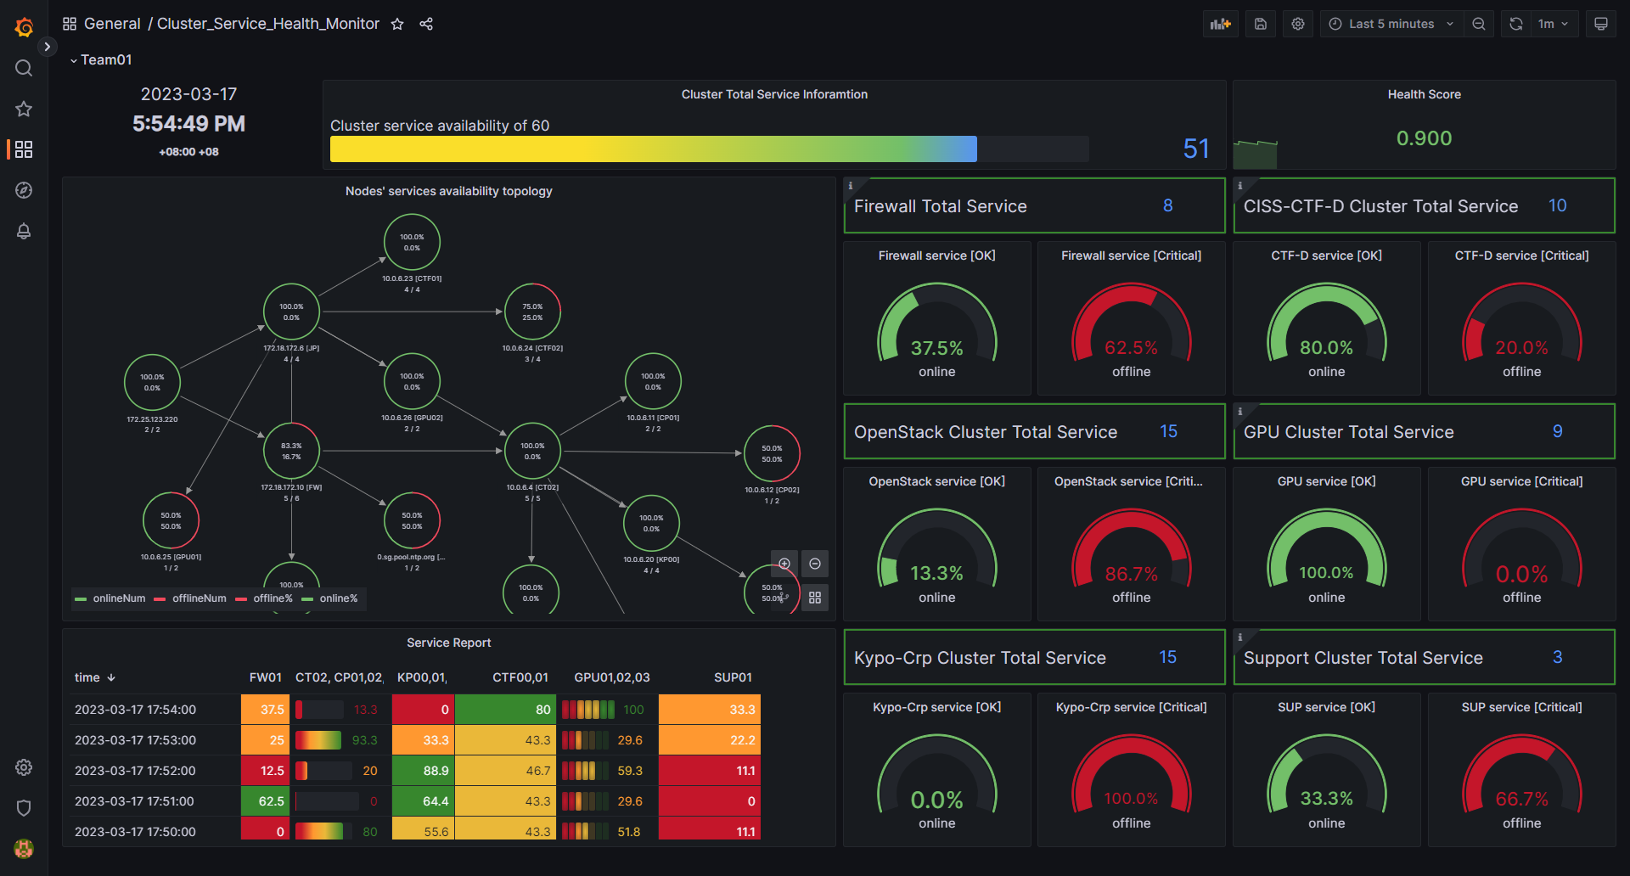
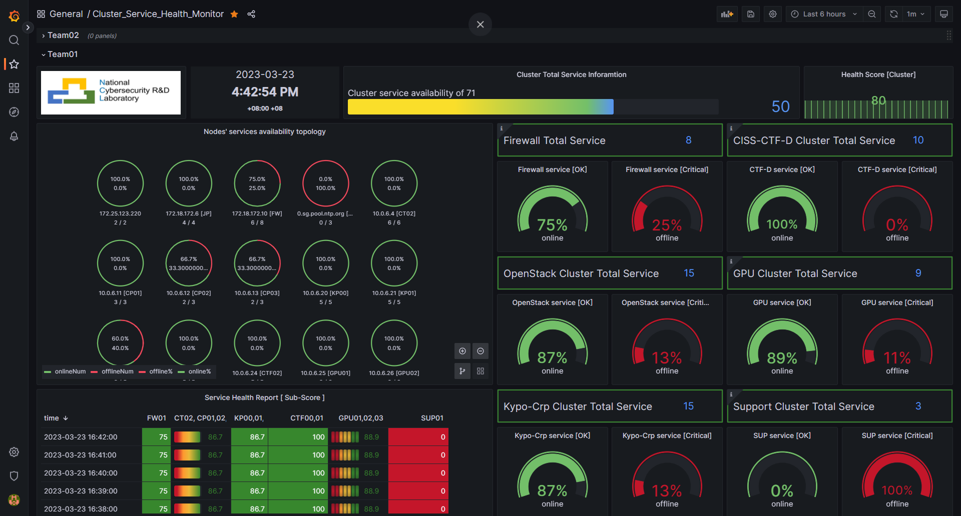
NCL Cyber Exercise Resource Monitor
2. Service Health Monitor Dashboard
The Cyber Exercise Service Heath Monitor dashboard is used by Blue team to monitor the health and availability of the sub exercise environment which they are working on. So they can analysis the state, raise tickets and plan the defence action. The information it can provide (Each team will have their own dashboard) :
Nodes health/availability state of the sub exercise environment.
Environment topology and traffic state.
Service health/availability and program execution state in the team’s cluster.
Node login and cmd execution state of the critical host/node.
Cluster system logs and current team’s defence score.
Service health dashboard example:

Slide 5
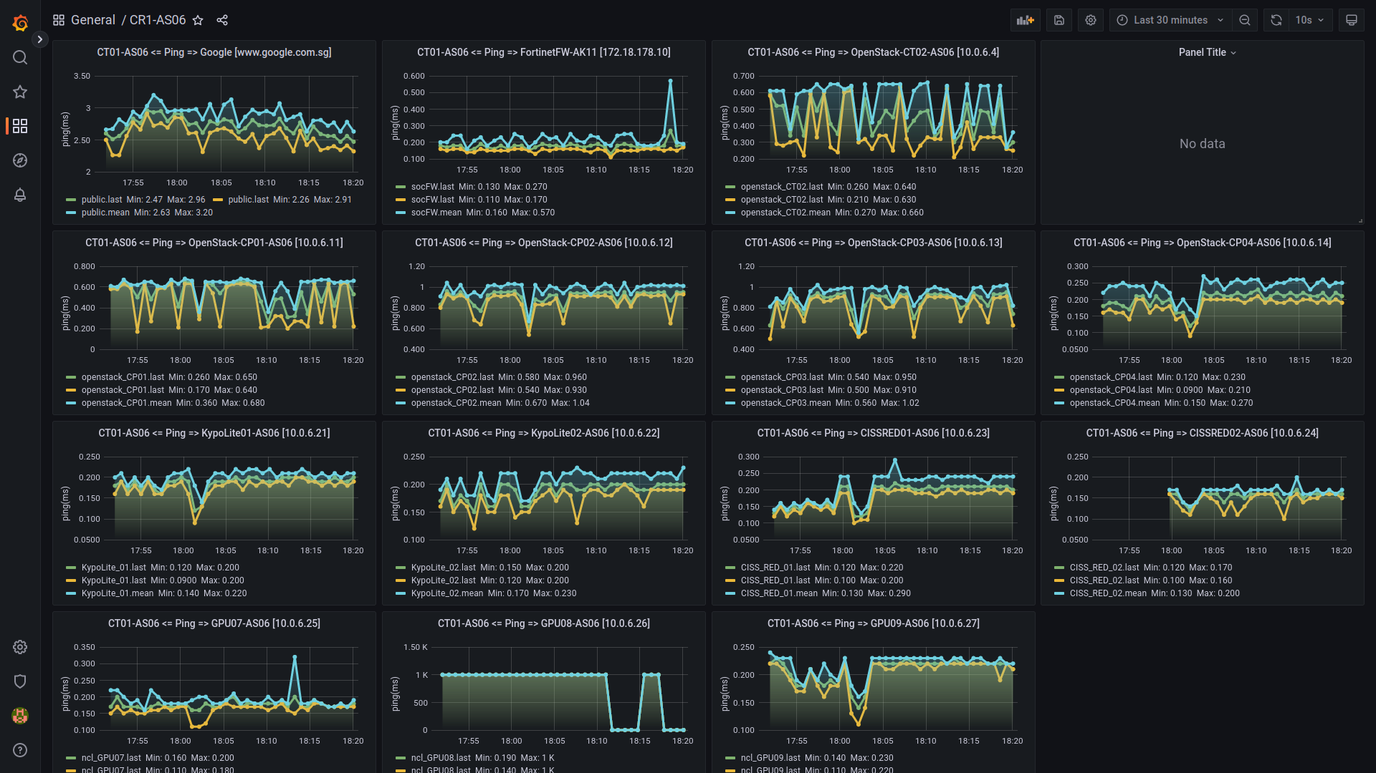
NCL Cyber Exercise Resource Monitor
3. Resource Availability Monitor Dashboard
The Resource Availability Monitor Dashboard will show detailed real time availability state of the resource ( hardware, vm, container, program or service) being used in the exercise. So
Black/Judgement team can use it to evaluate specific teams’ score or action.
Red team can use it to check the influence of the exercise cluster after they launched the attack.
Green team can used to monitor the critical infra’s connection, analysis the event process and debug the exception situation happens during the event.
Purple team can use it to archive the exercise cluster’s whole resource situation.
Resource availability dashboard example:
Critical Nodes Connection dashboard example:

Slide 6
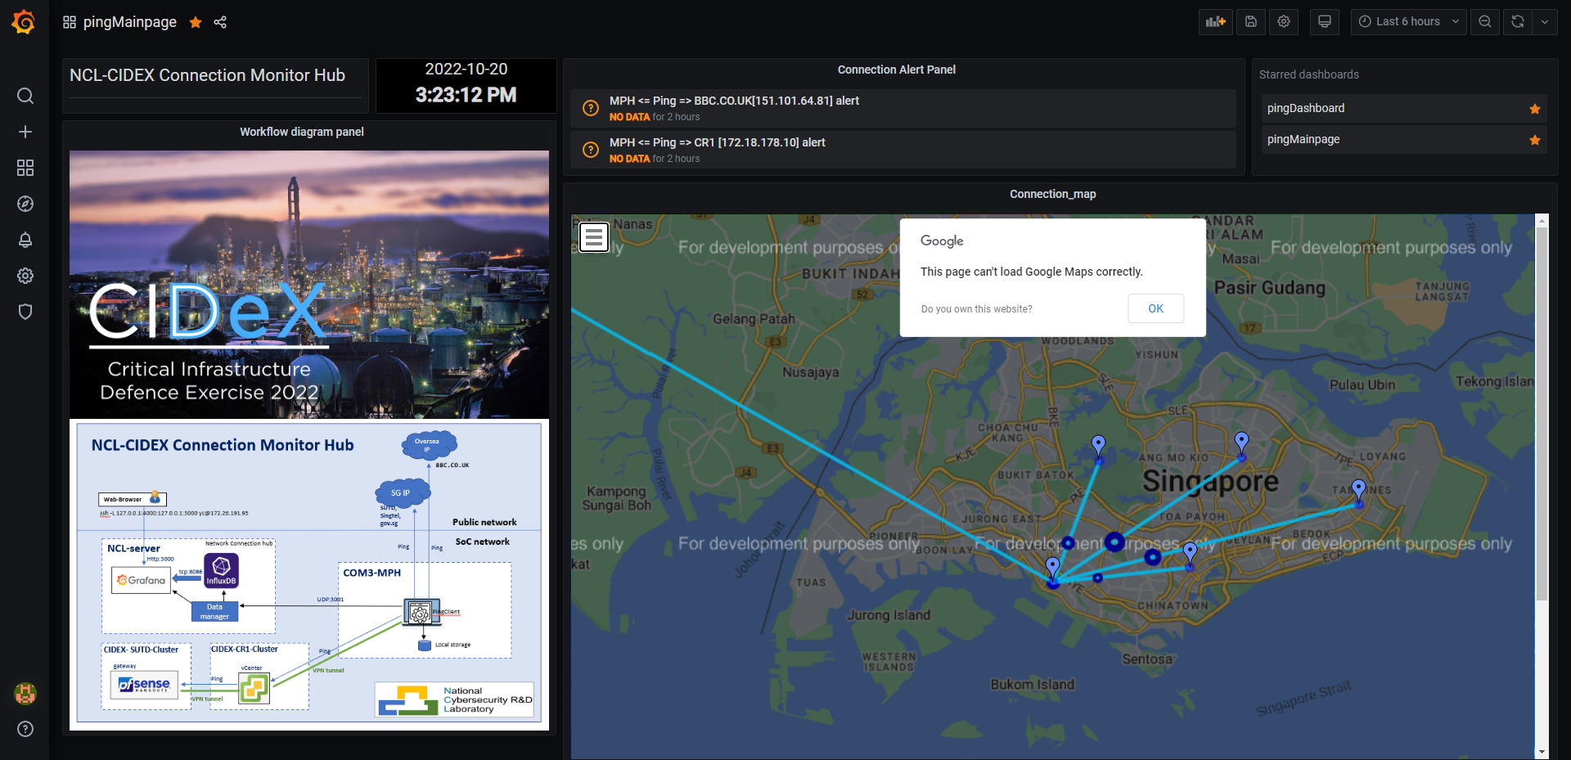
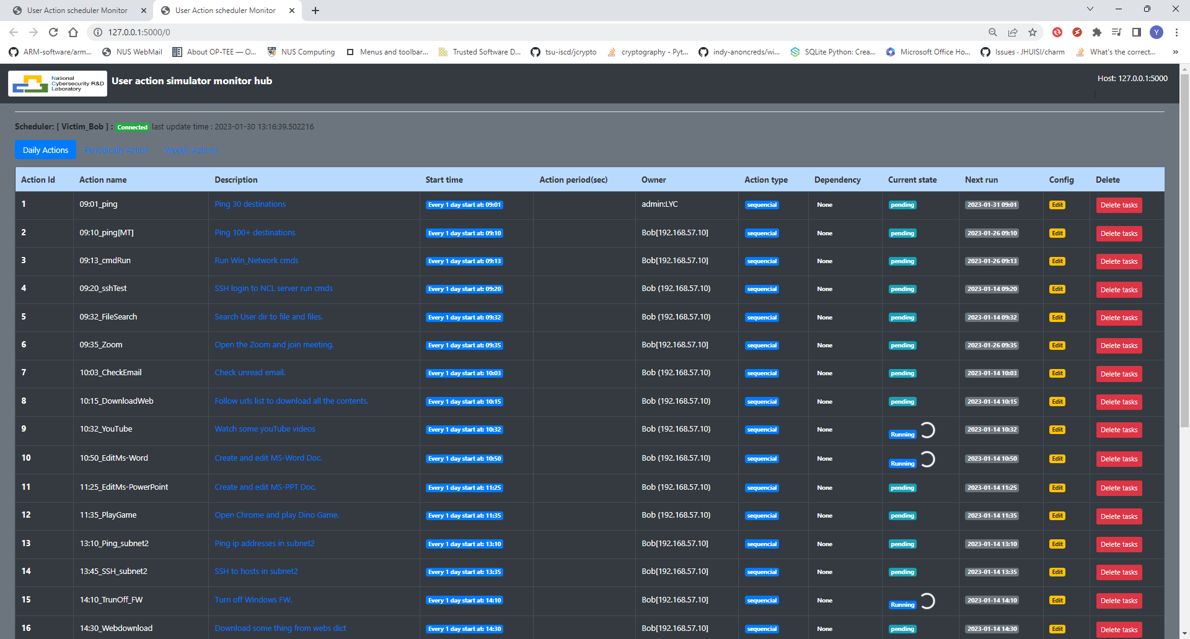
NCL Cyber Exercise Resource Monitor
4. Assistance function Dashboard
The assistance function dashboard are the customized dashboard which provide the specific function to full filled the customers’ requirement. Current dashboard includes:
The normal users’ behavior simulation and traffic generation state dashboard for Yellow team.
The attack auto launch and unexpected(harmful) action auto trigger state dashboard for Red team
The internet connection monitor, VPN bandwidth usage state monitor dashboard for Green Team to support the event.
Internet and VPN Peer Connection monitor dashboard (used by Green team) example:
Auto attack, normal user simulation and traffic generation monitor dashboard:

Slide 7
NCL Cyber Exercise Resource Monitor
Technical detail
The Cyber Exercise Resource Monitor is built based on two exist product: Cluster User Emulator and Cluster Service Health Monitor.

Slide 8
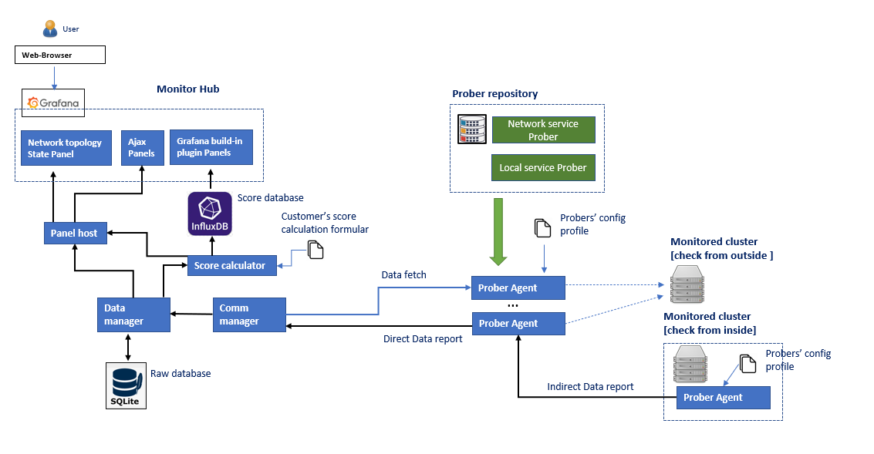
Cluster Service Health Monitor
Introduction
The Cluster Service Heath Monitor is a system function/service monitoring program to check and evaluate the cyber security computing cluster's critical points (node, service, function, file system) availability in real time during the cyber exercise. The system contents three main parts and the system workflow diagram is shown below:
Service Prober Repository : A service checking lib with several different prober functions (such as check NTP, FTP, VNC, ssh ...) to detect whether a specific node / service / program / function is working normally.
Prober Agent : A agent collects and schedules several different kinds of probers to check the entire availably of one or multiple targets’ working state in the cluster.
Monitor Hub : A data visualization and analysis system provides database to archive data, a web-based dashboard for user to check the monitored cluster's state and the interface for user to plug in their score calculation formular / function are also provided.
System Workflow Diagram

Slide 9
Cluster Service Health Monitor [ Service Prober Repository ]
Introduction
Service Prober Repository is a prober module lib to provide the service / program function check function. The prober function can be categorized to three parts: local service probers, children agent prober and network service probers.
Local service prober : The local service prober will run inside the target node to monitor the nodes resource usage (CPU%, Memory, Hard disk, user), network state (port opened, connection, NIC I/O state), local program execution state (process) and file system modification. The probers details are shown below:
Network Service prober: The service prober run outside the target nodes to check the node's services state through network. The probe functions provided are shown below:
Prober Name | Probe action/ service covered
Server active Prober | ICMP (ping), SSH(login), RDP, VNC, X11/X11:1-Win
Service ports prober | Use a customized Nmap lib check whether the node's request service ports are opened.
Service function prober | NTP service prober : Check the NTP service latency and time offset correctness.
 | DNS/NS service prober: Check the dns service name mapping correct.
 | DHCP service prober: Check the dhcp broadcast.
 | FTP service prober : Whether can login the FTP server and list the directory tree.
 | Http/https web prober: Check the webserver can handle request correctly
 | Email service prober: Check whether the email server is working normally
 | TCP/UDP service prober: Service use TCP/UDP connection. (such as MS-Teams, Skype service)
 | Database service prober: Check the database connection
Prober Name | Probe action/ service covered
Resource usage Prober | CPU %, Memory %, Hard Disk %, Network Bandwidth Usage.
User action Prober | User login, cmd executed, file system modification.
Program action prober | Program execution, process started, service port opened, program log check.
Children Agent prober : A prober to fetch data from other prober agent program and merge the data. This prober is used for link the subnets which only linked with jump host without set routing table.

Slide 10
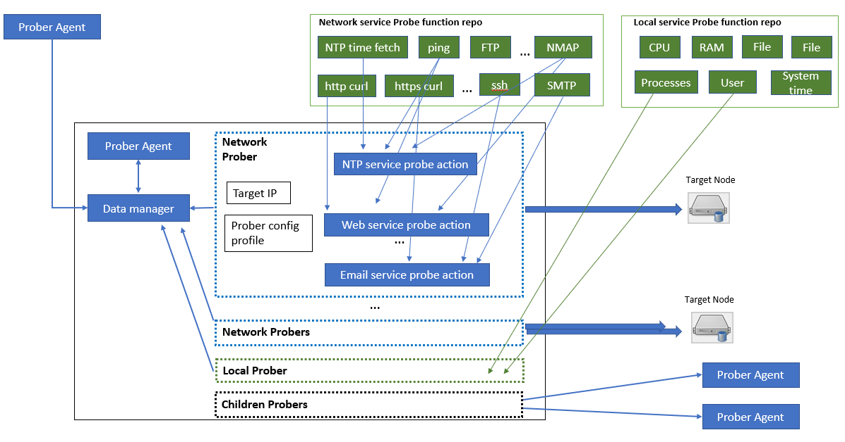
Cluster Service Health Monitor [ Prober Agent ]
Introduction
An agent program collects and schedules several different kinds of probers based on the customized config profile to check the entire service availably of a small cluster. The prober agent provides below 5 main features:
Configuration base on profile : User can easily use their customized profile to config all probers’ execution timeline.
Probing from outside/Inside : Agent can run inside the critical node to check the node's local state or run outside in a node to check the service interface of multiple nodes. So, the customer can deploy the agents based on his monitor priority instead of deploying agent to every node.
Customized prober plugin : It also provides the interface for customer to plugin their customized probe function for specific service (such as a check a billing server).
Data report bus: To avoid changing the original routing config of a cluster, a prober agent can also fetch data from the other touchable prober agents to build a data translation bus/chain to make the deployment easier.
Multiple connection protocol : The agent provide different network protocol for data fetch/report (TCP, UDP, HTTP, HTTPS) to fit for the network traffic limitation requirement in a cyber exercise.
The workflow Diagram of prober agent and relationship between Service Prober Repository and prober agent:

Slide 11
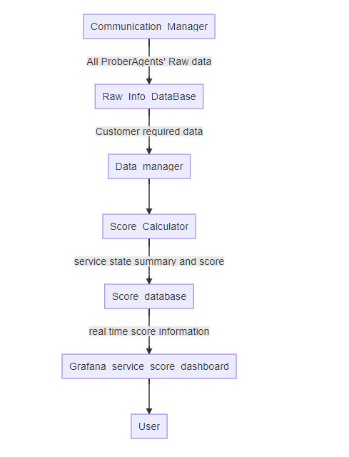
Cluster Service Health Monitor [ Monitor Hub ]
Introduction
The monitor hub is a data processing, analysis and visualization system. All the prober agents will report their monitor result to the monitor hub via communication manager. The monitor hub provides a web-based dashboard (currently we are using Grafana) for users to check the monitored cluster's state, a topology diagram to show the clusters’ services online state and it also provides the interface for user to plug in their score calculation formular/function. The data flow diagram is shown on the right side.
Two data bases will be included in the program:
Raw info database: A database used to archive all the collected service data.
Score database: A database save all the data need to be visualized in the score database.
The data manager will fetch needed data from Raw-Info-DB, process and analysis the raw data and calculate the service core based on customer's score calculation function, then insert/update the data in score database.

